Slide 1
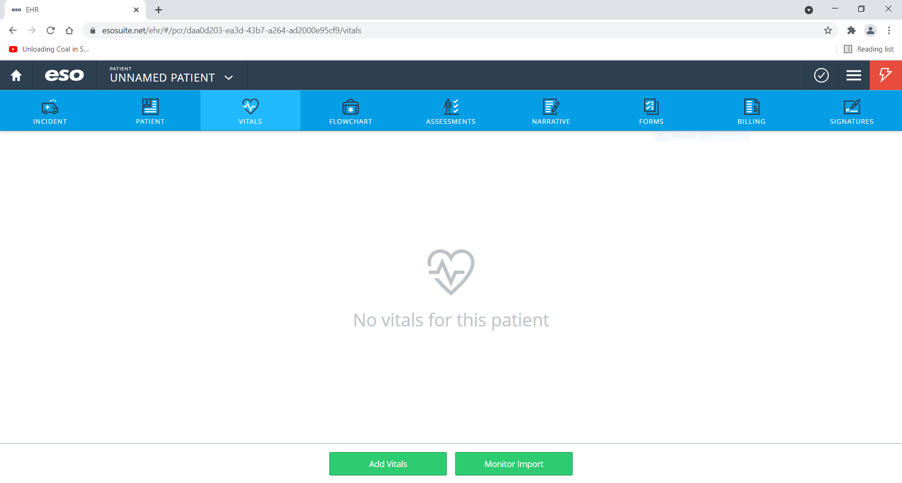
Starting a Set of Vital Signs
1. In EHR, click Vitals.
2. Click Add Vitals

Slide 2
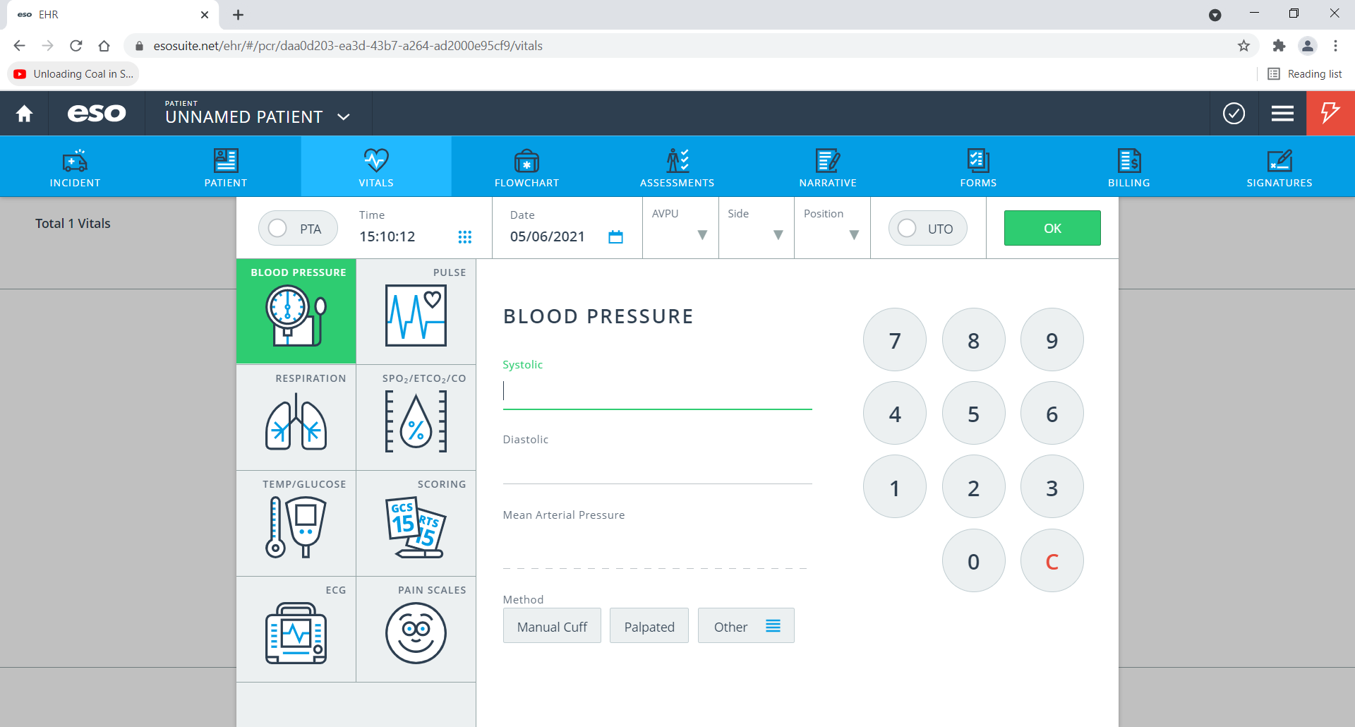
Entering a Systolic Blood Pressure
3. Enter Time
4. Click Blood Pressure
5. Enter Values

Slide 3
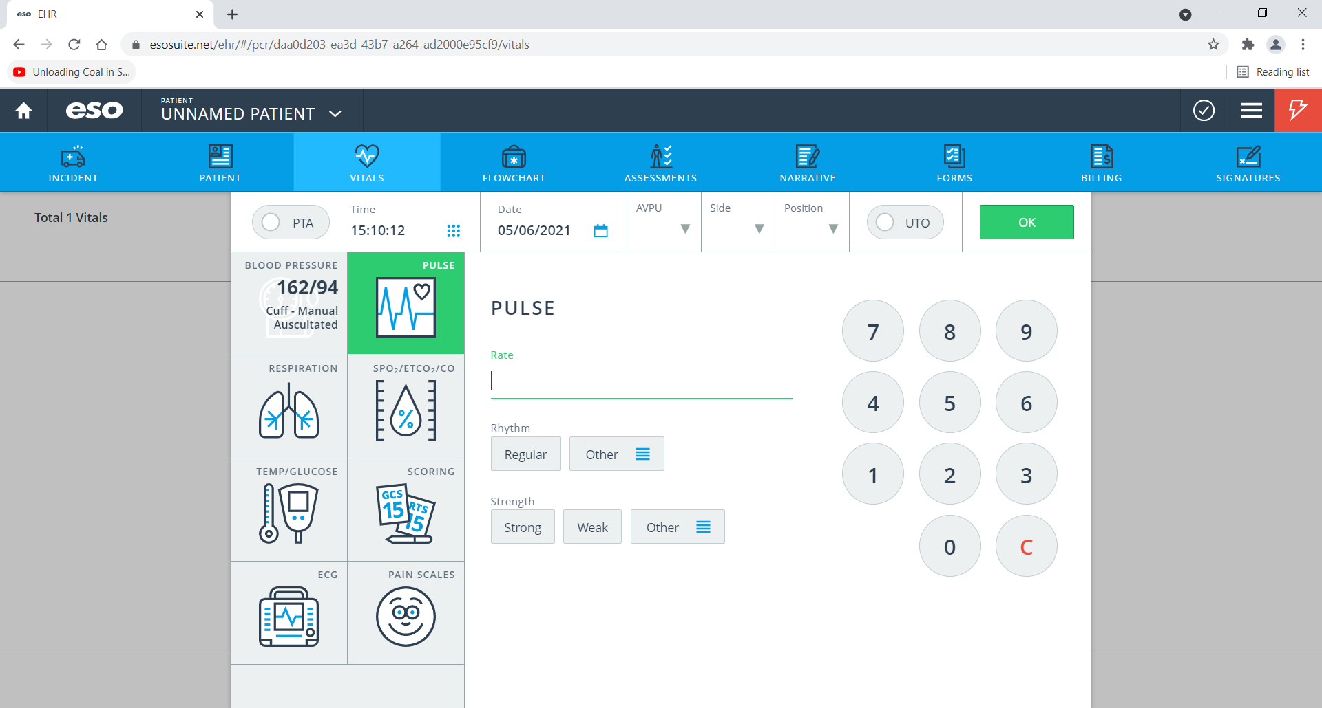
Entering a Pulse
6. Click Pulse
7. Enter Values

Slide 4
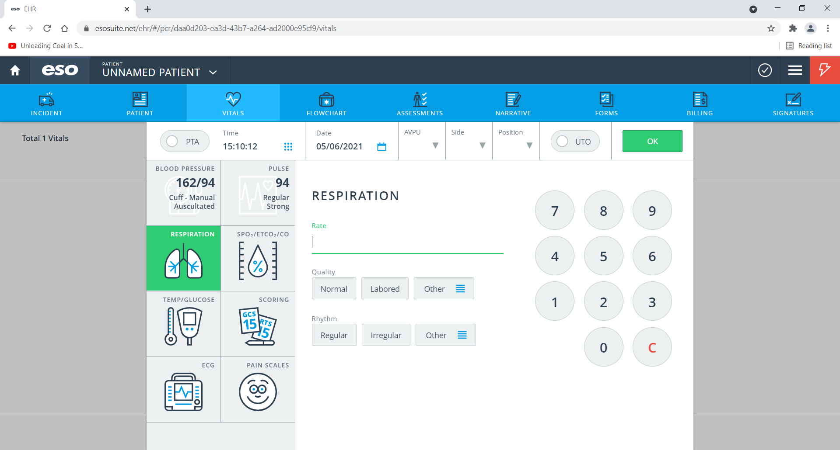
Entering Respirations
9. Enter Values
8. Click Respirations

Slide 5
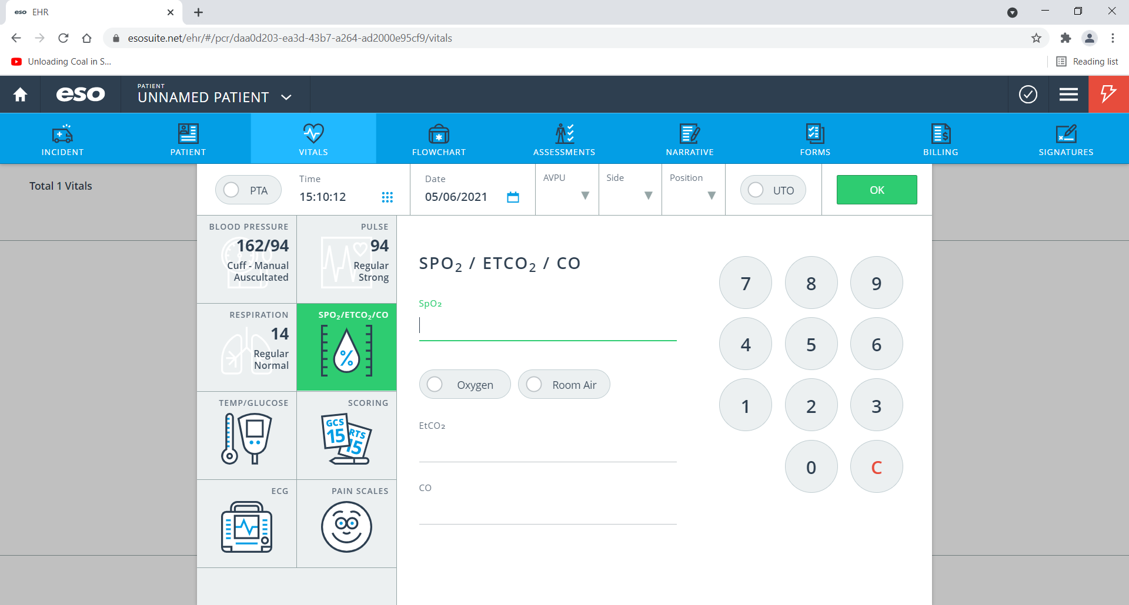
Entering SpO₂
11. Enter Values
10. Click Respirations

Slide 6
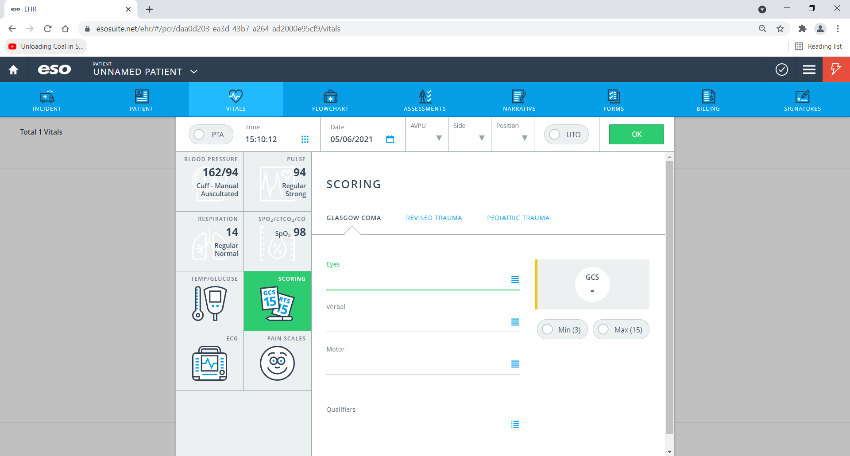
Entering Glasgow Coma Score (GCS)
13. Enter Values under Glasgow Coma
12. Click Scoring

Slide 7
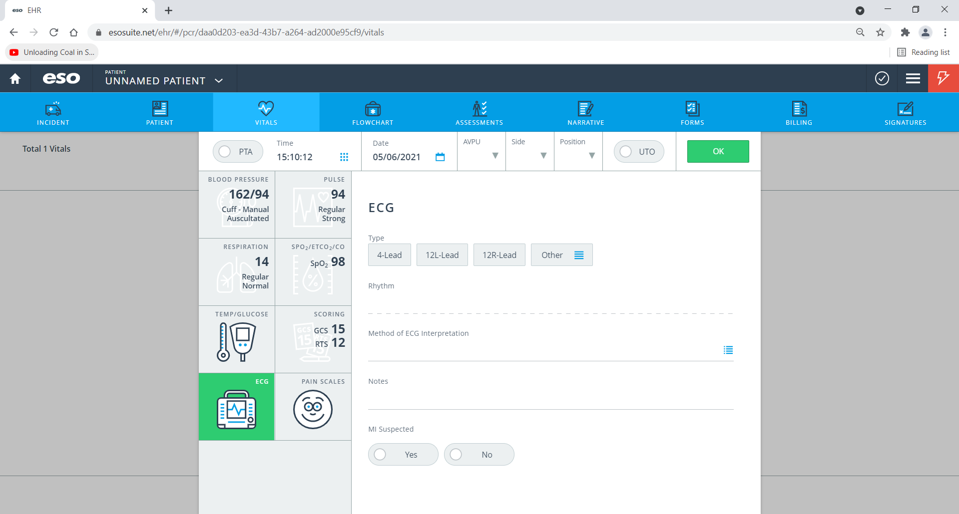
Finishing Entry
14. Click OK.

Slide 8
